Slide 1
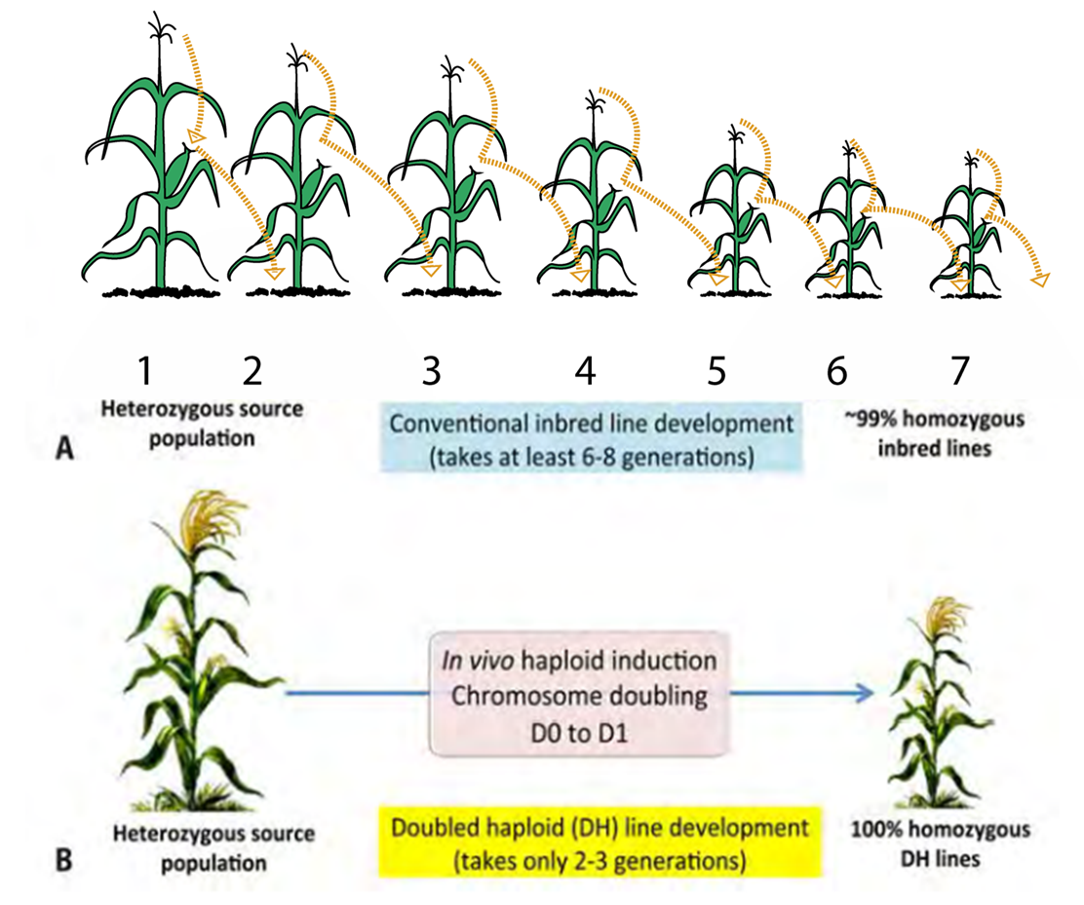
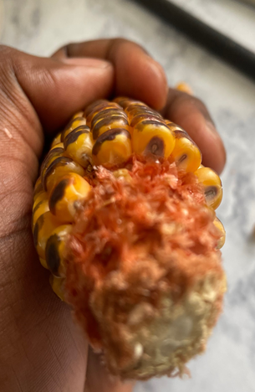
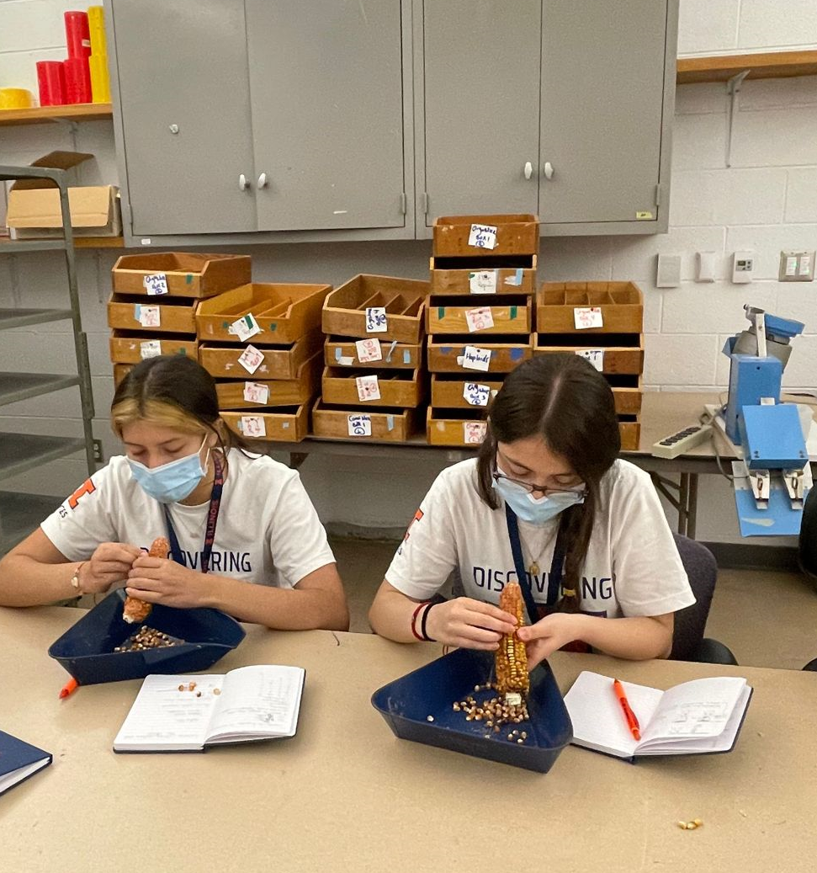
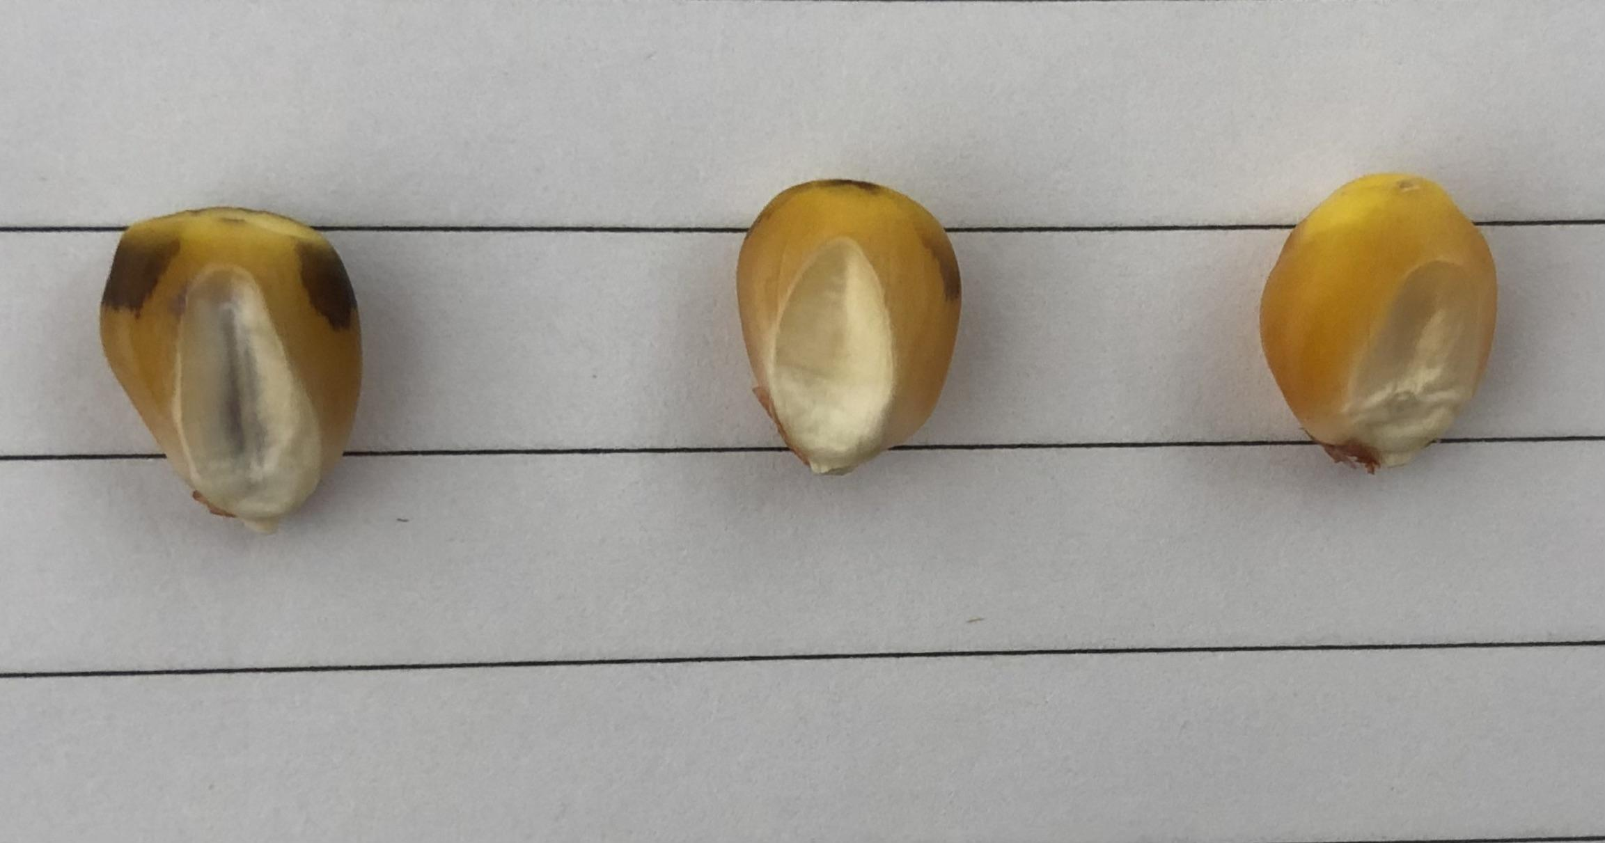
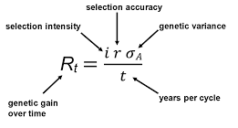
Introduction to Doubled haploid technique in corn breeding (Speed Breeding)
Breeder’s Equation
Diploid
Haploid
Contamination

Slide 2
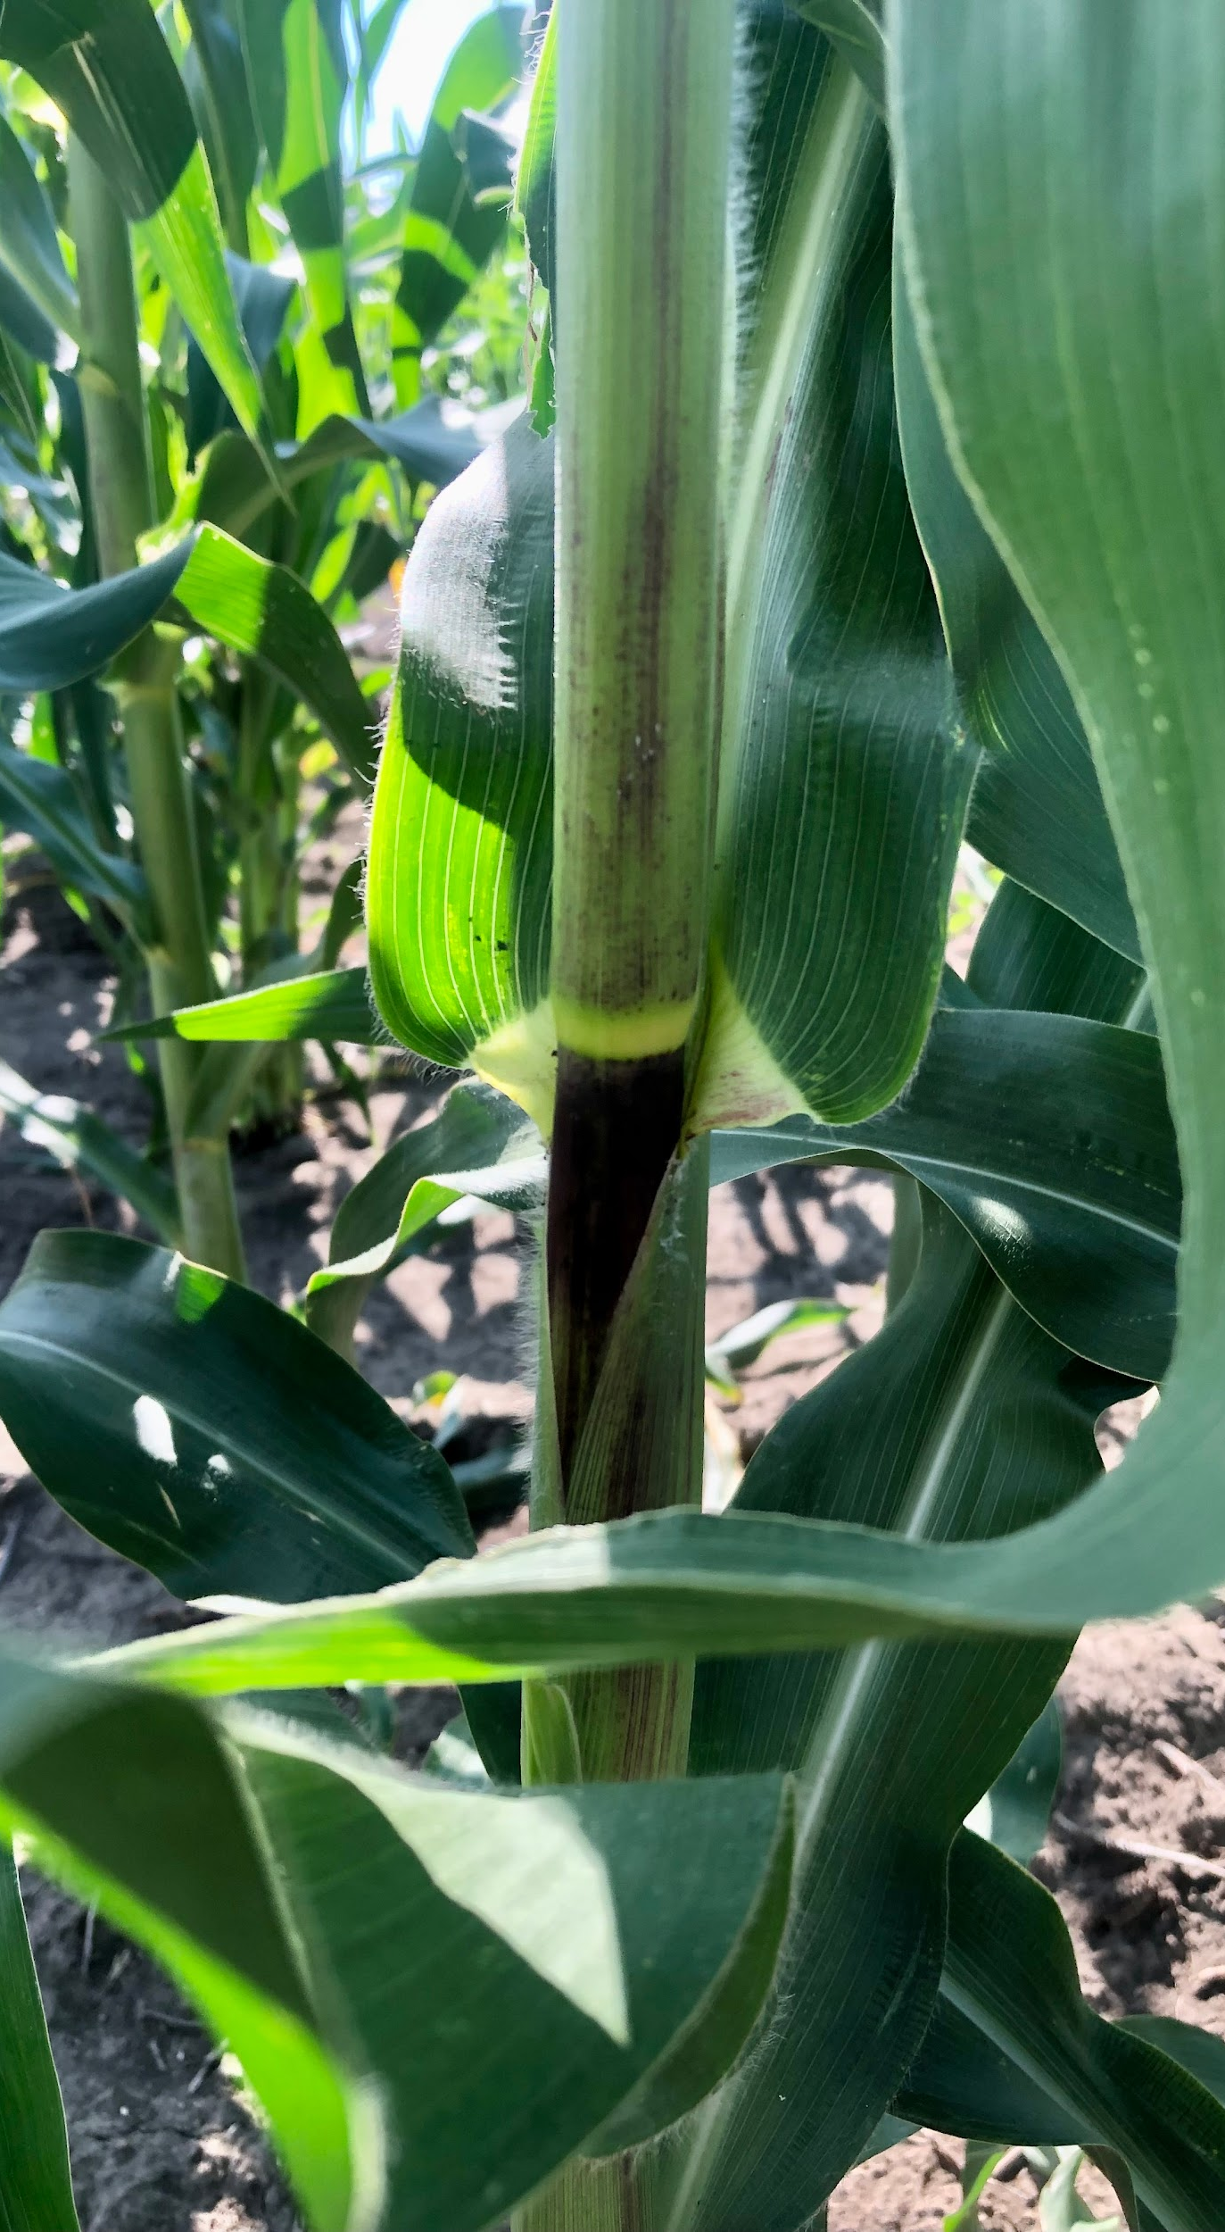
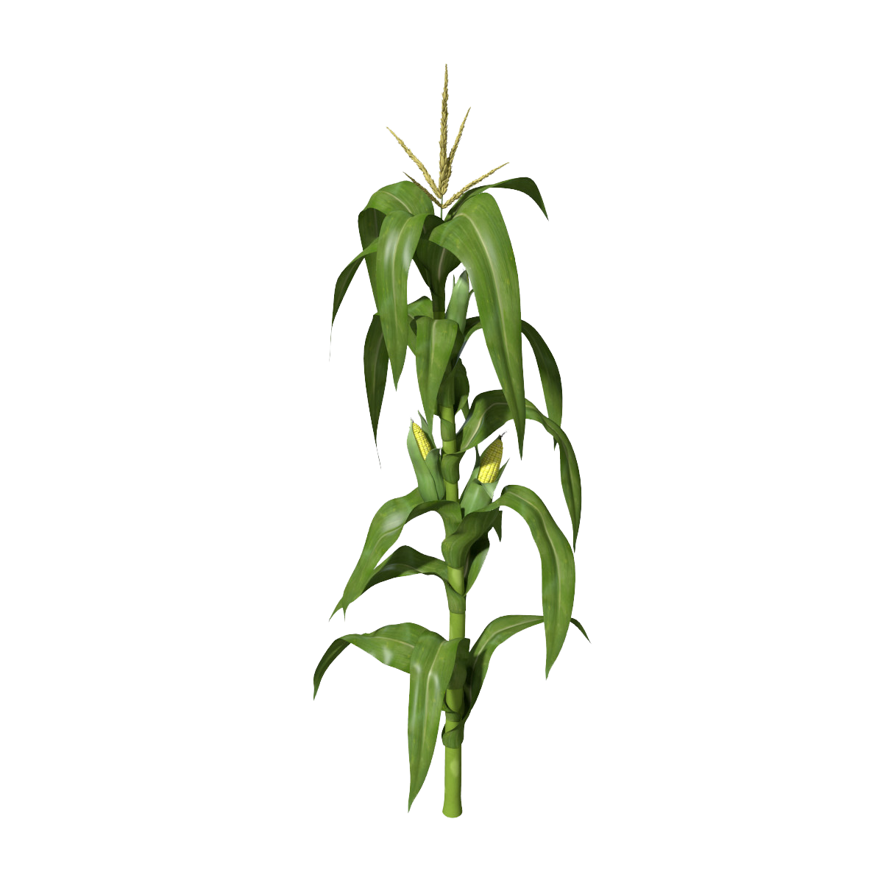
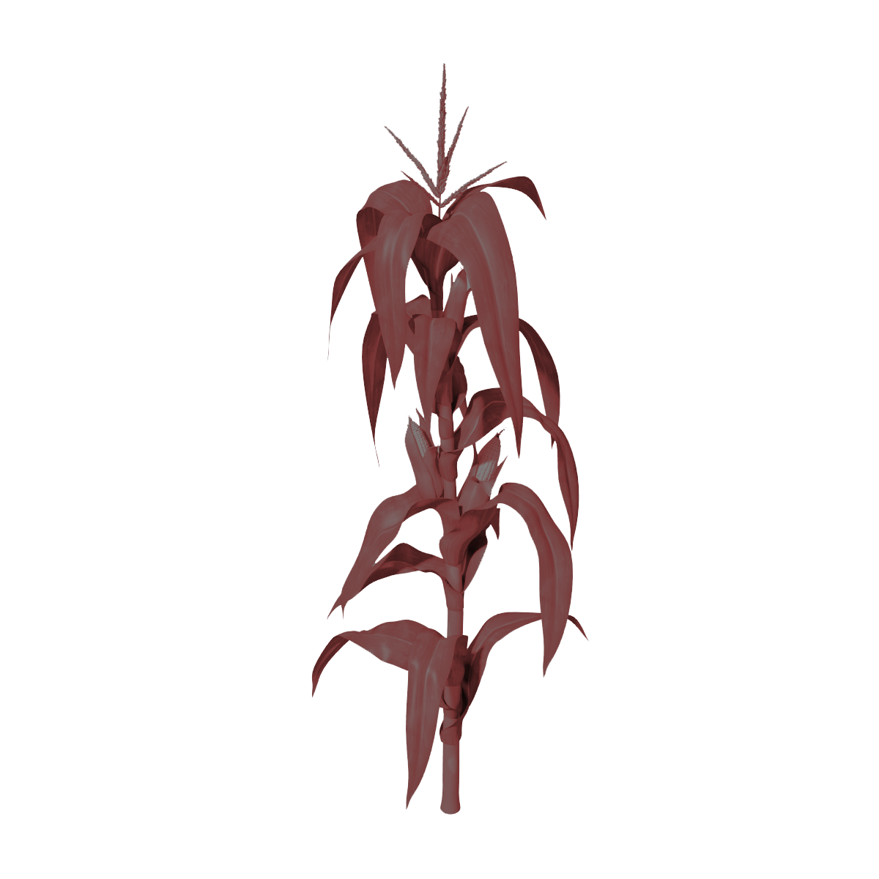
Haploids & Diploids
Diploids: Have two sets of chromosomes (2n)
Haploids: Have one set of chromosomes (n)
Successful crossing if inducer color can be seen
2n
2n
n
“Mother”
Has desired
trait
Inducer Line
“Kicked out”
Holds desired trait
Very weak, won’t survive by itself
Notes:
Corn Plant: https://www.pngmart.com/image/5226

